Slide 1
Software Development Project on Mobile Design Application
Music App:GABA
Submitted By:
Amninder Kaur
Amardeep Kaur
Babita Pal
Gurpreet Kaur
Gagandeep Kaur

Slide 2
Introduction
GABA is a music appilication of Bollywood, English and other regional Indian music across the world. It is a freemium service. The basic features are streaming quality and music downloads. Partnerships with Facebook,Instagram and Twitter.

Slide 3
Products and services
GABA
It provides music service that offers offline listening without advertisements, and its a mobile app, for iOS and for Android.It allows users to follow the profiles and playlists of celebrities. Users can share any song, album or playlist with their friends.

Slide 4
What it includes??
SignUp
Login
Forgot Password
Home page
Menu
Songs
Artist
Album
Feedback
Settings

Slide 5
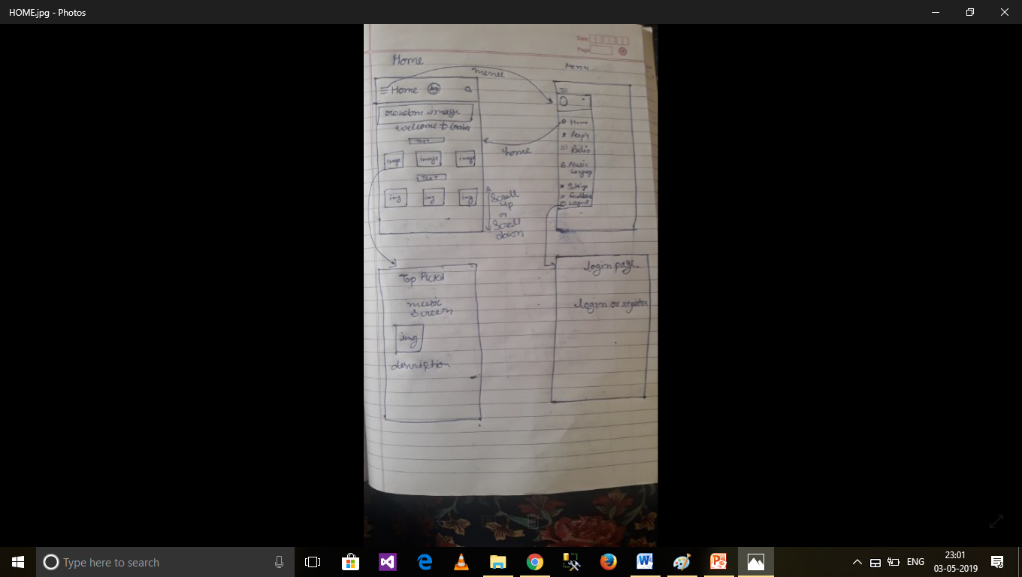
Low Fidelity: Home Page

Slide 6
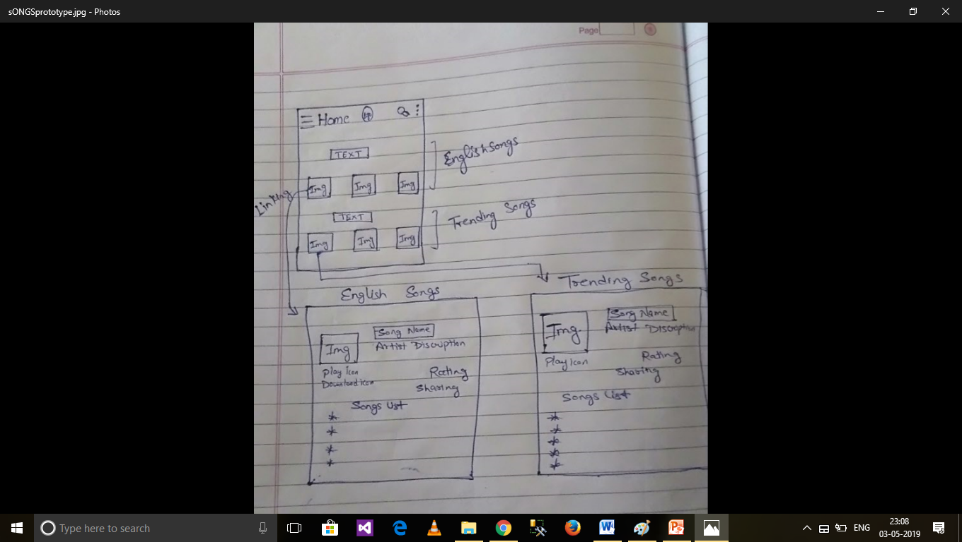
Songs low fidelity screen

Slide 7
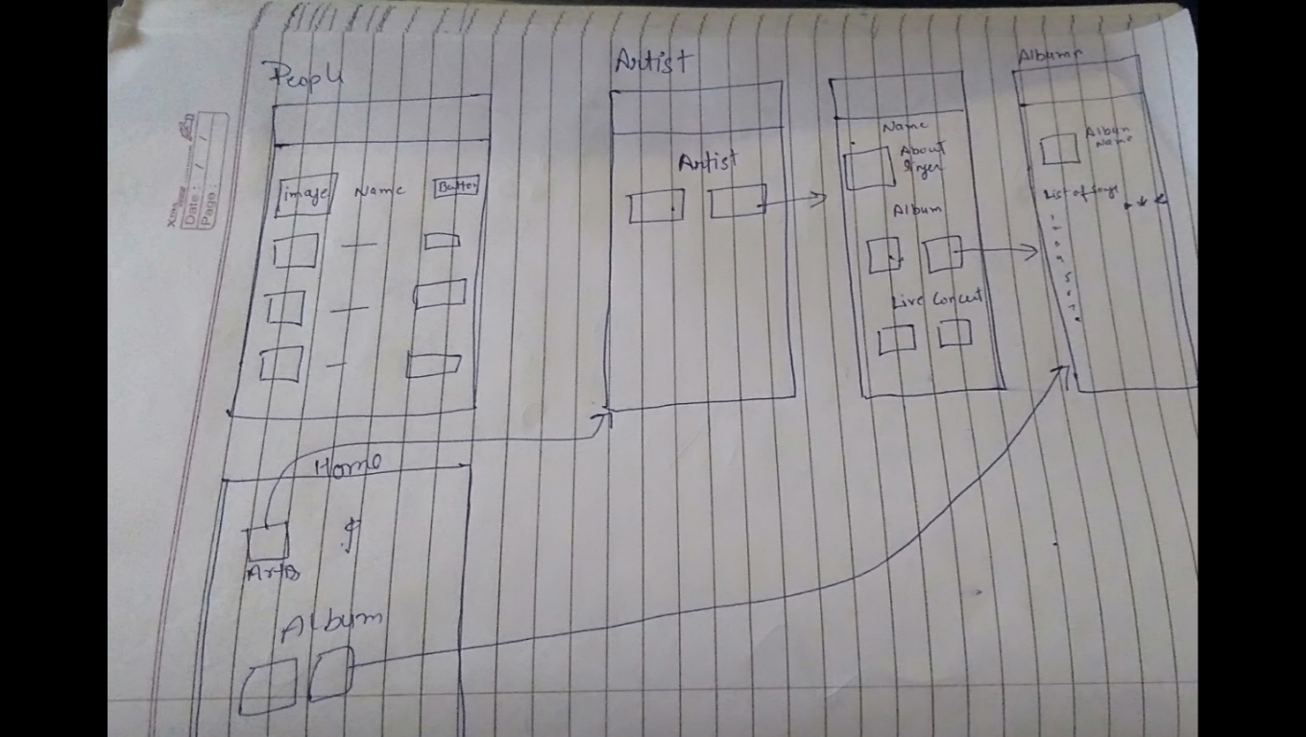
Artists and Album low fidelity

Slide 8
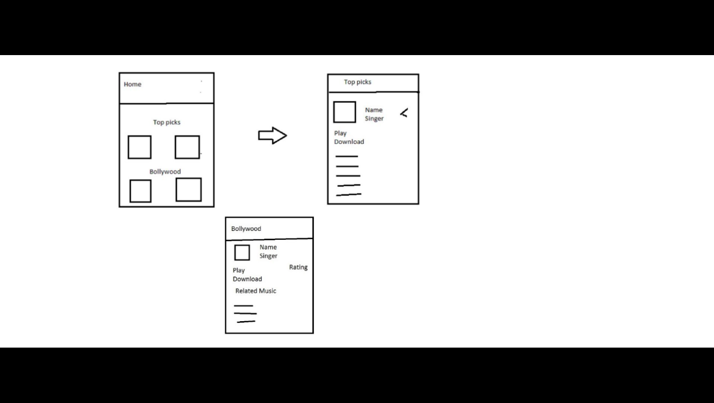
Top picks and Bollywood

Slide 9
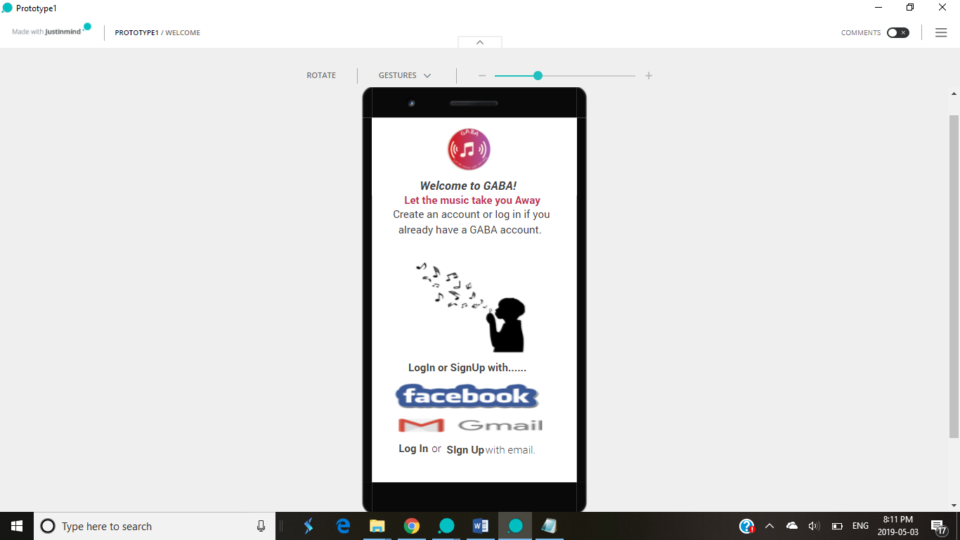
Welcome Page
At welcome page user can login or signUp to enjoy the richness of music.

Slide 10
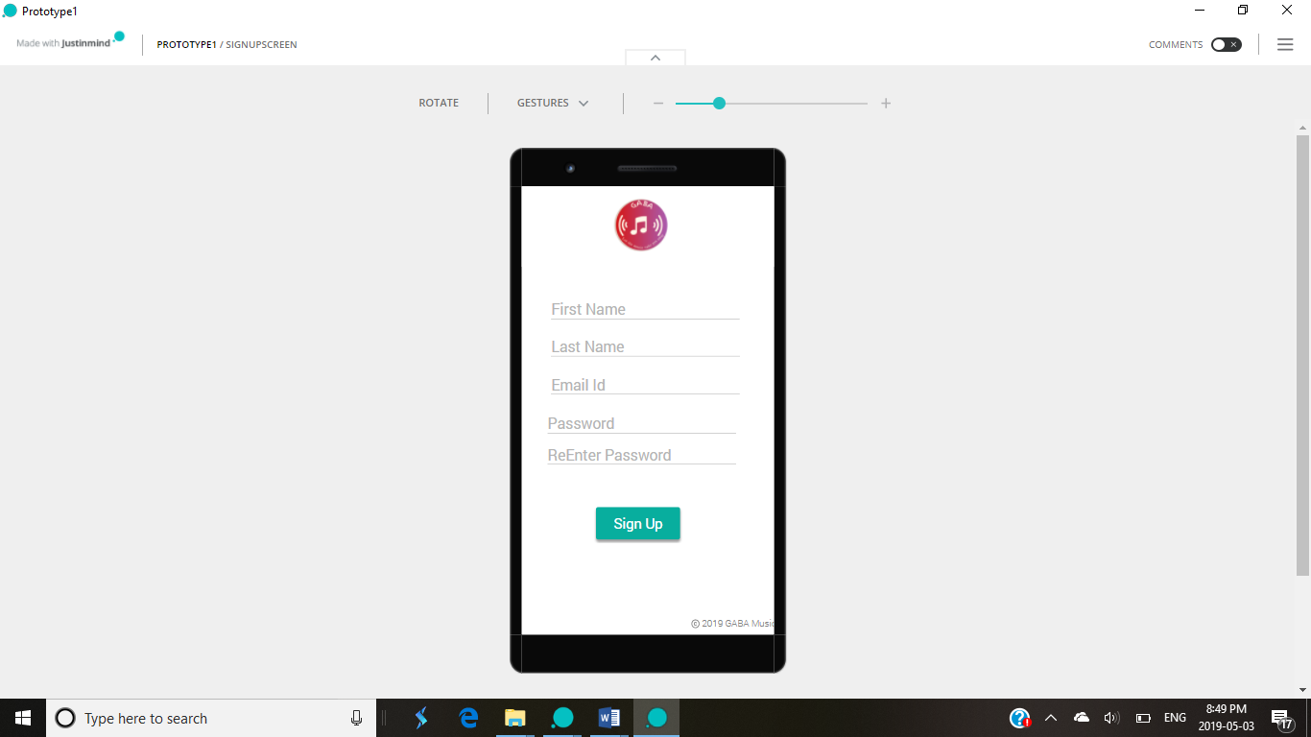
Sign Up

Slide 11
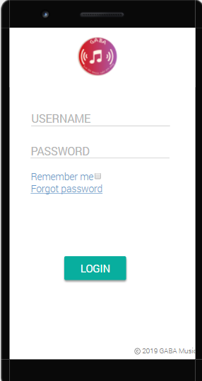
Login
To access the login is necessary for the user. User required username and password. User do not need to worry about if he forgot password he can retrieve by clicking Forgot password icon which will reset new password.

Slide 12


Forgot Password

Slide 13
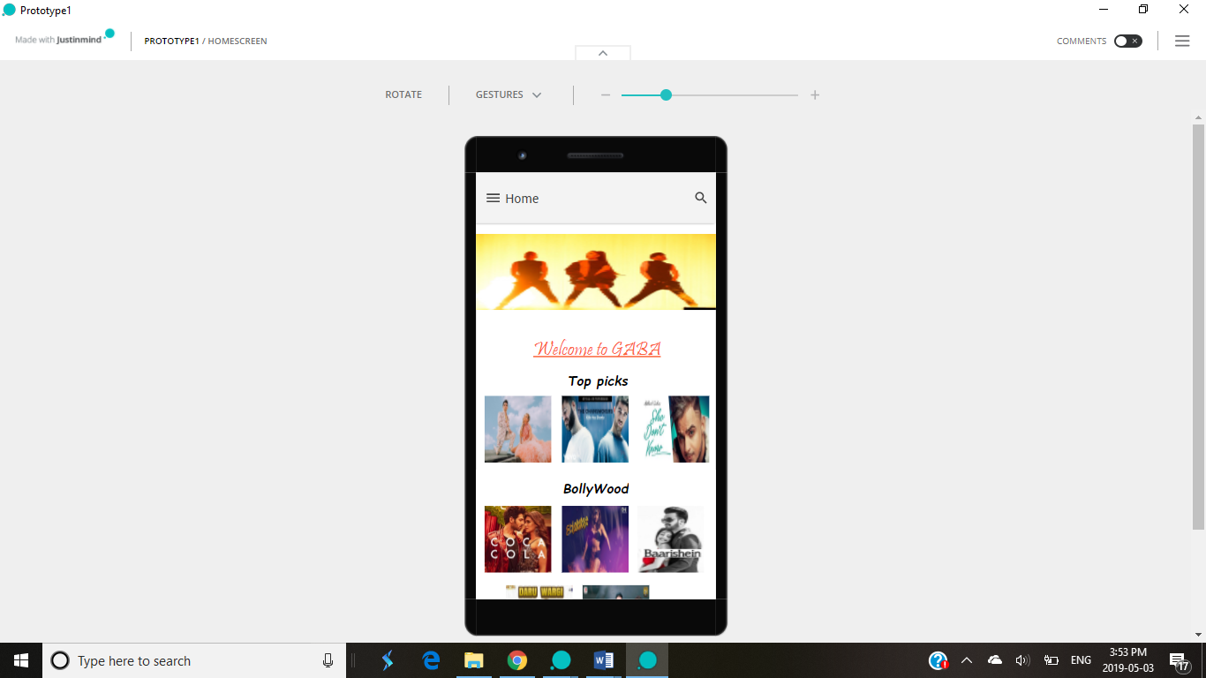
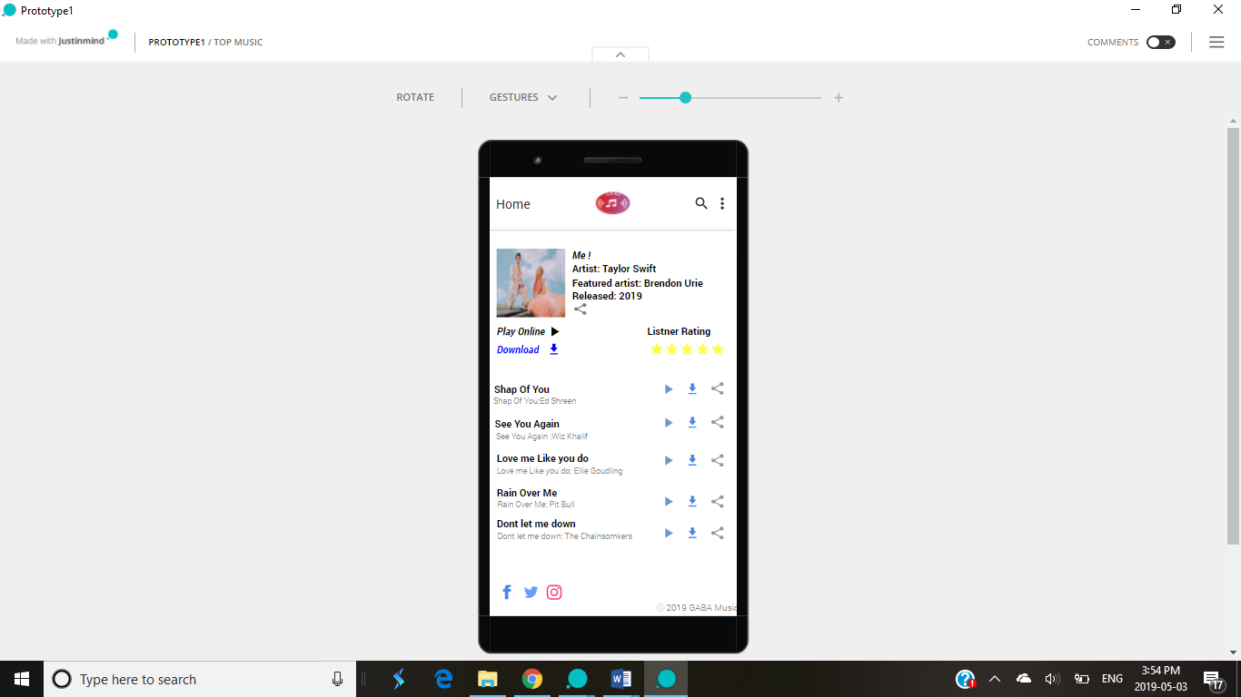
Home Page
Top picks

Slide 14
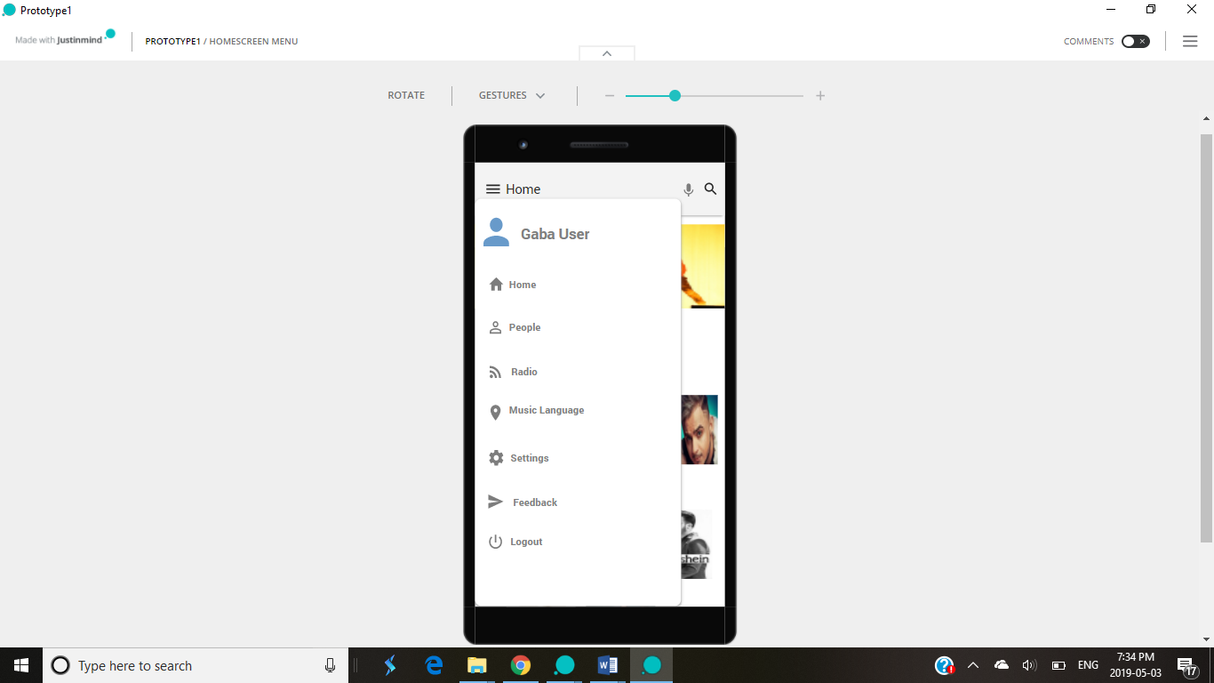
Home Menu
In Home menu, a GABA user can enjoy the encapsulation of various pages like Home, People, Radio, Music Language, Settings, Feedback and Logout features.Here, user can follow his or her favourite aritsts.

Slide 15
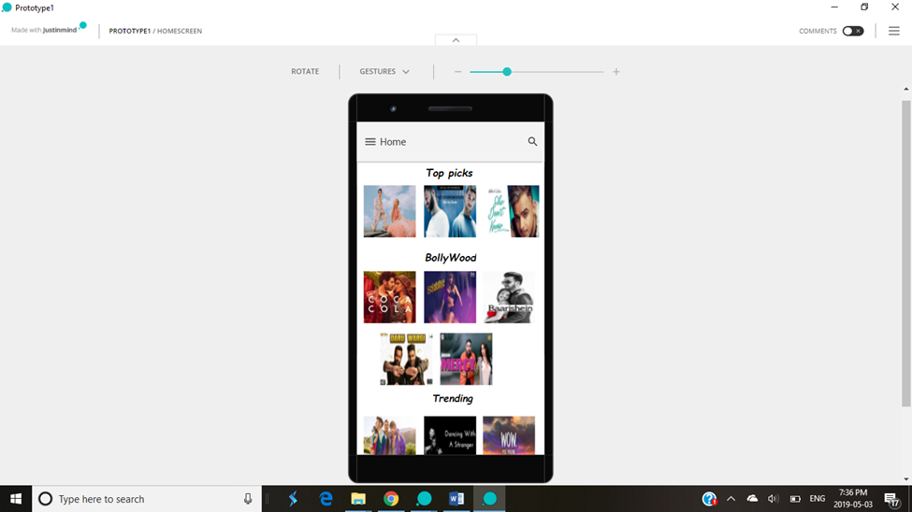
Music Gallery
Gallery has all music types such as bollywood, top picks, mixer of trending, English music, artists and their albums.
Top picks will show the songs which are being highly liked by the audience.
Bollywood give users hindi film songs form a predominant component of Indian pop music, and derive their inspiration from both classical and modern sources.

Slide 16
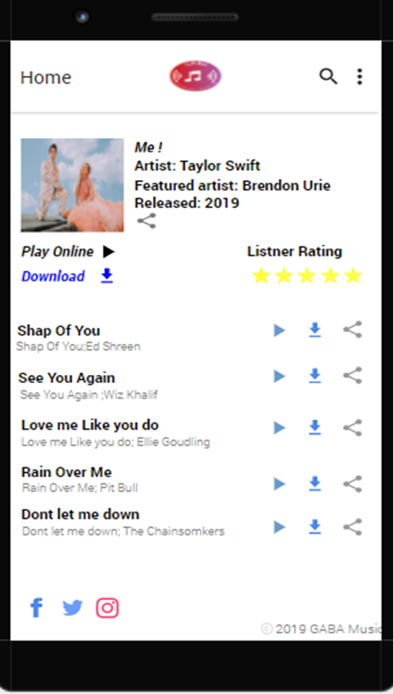
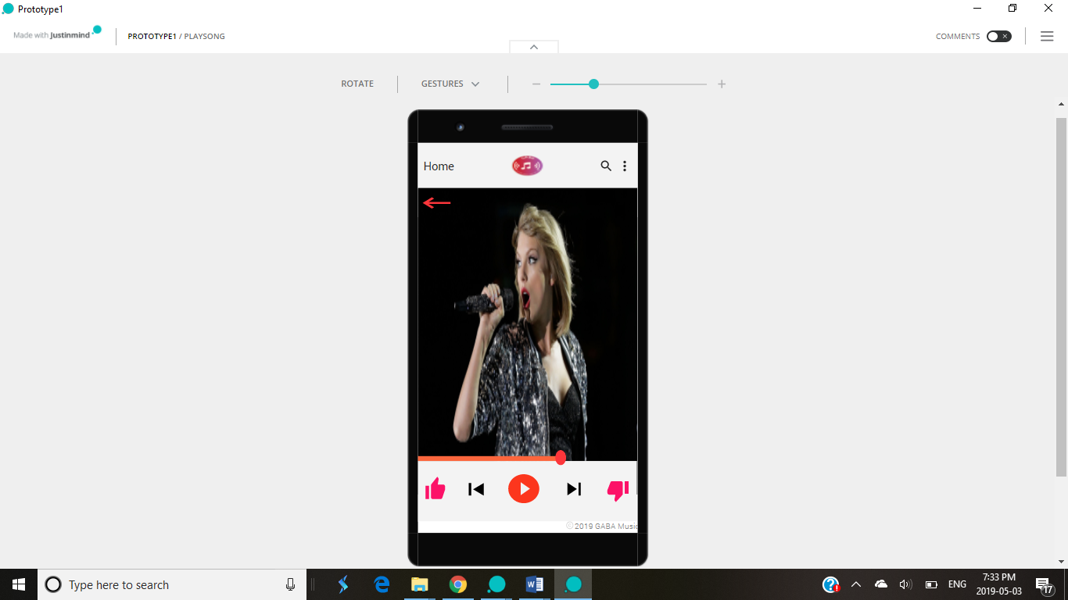
Music Play Screen
After selecting song

Slide 17
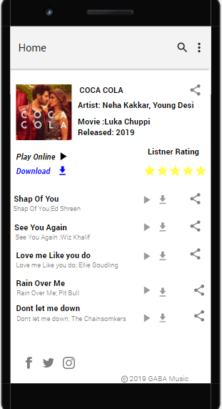
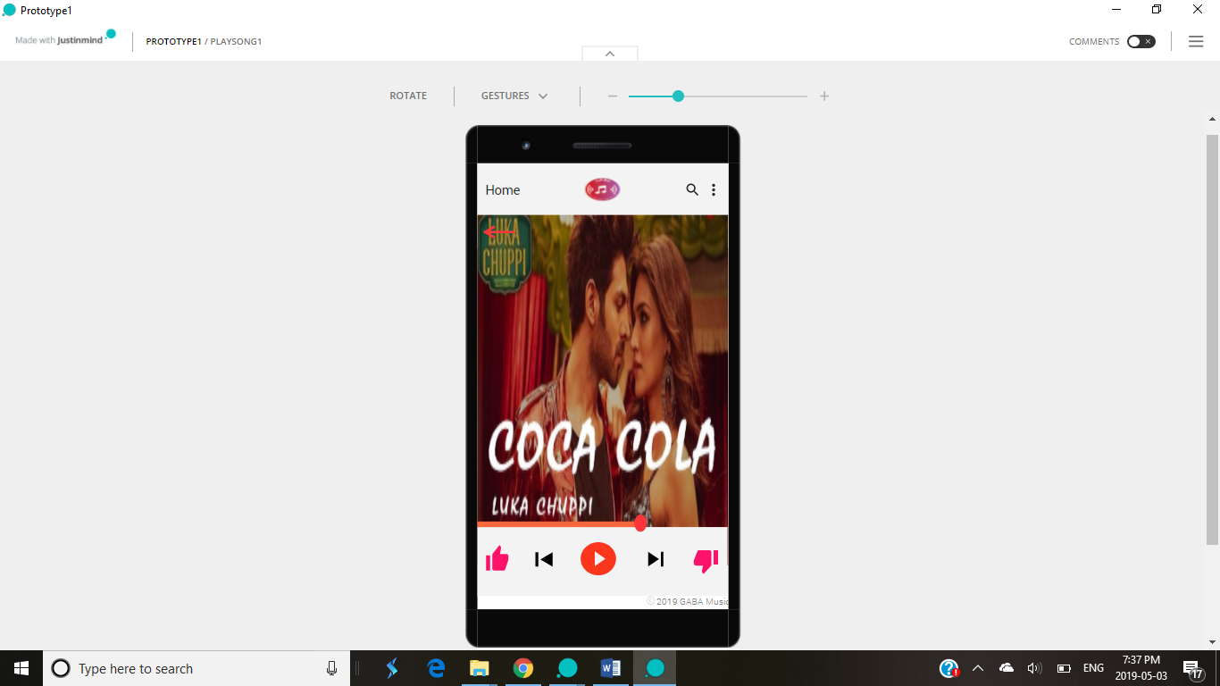
Bollywood Music
Playing Bollywood song

Slide 18
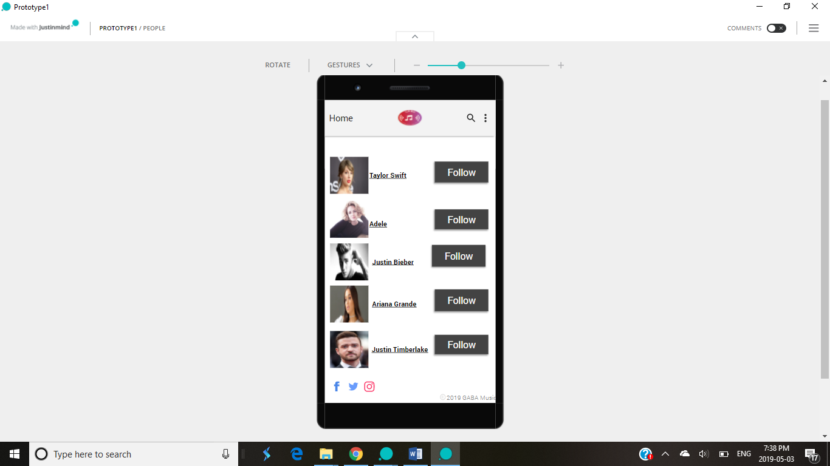
Follow your Celebrities

Slide 19
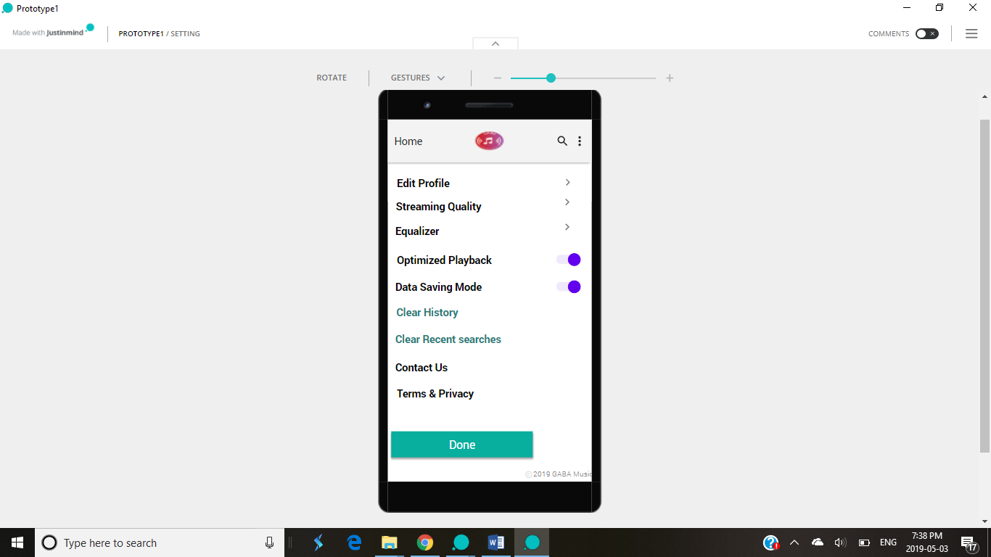
Setting Page
Setting page adds more effectiveness in the music app where user can enjoy utmost features like edit profile, streaming quality, equalizer, optimized playback, data saving mode, clear history, clear recent searches, contact us and term & privacy.

Slide 20
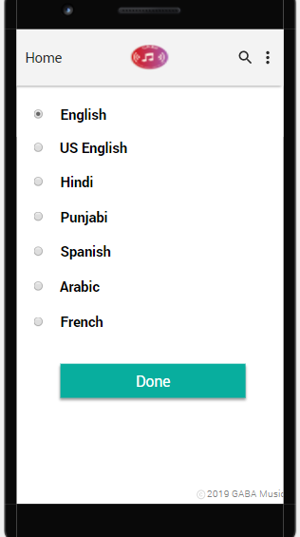
Choice of Language

Slide 21
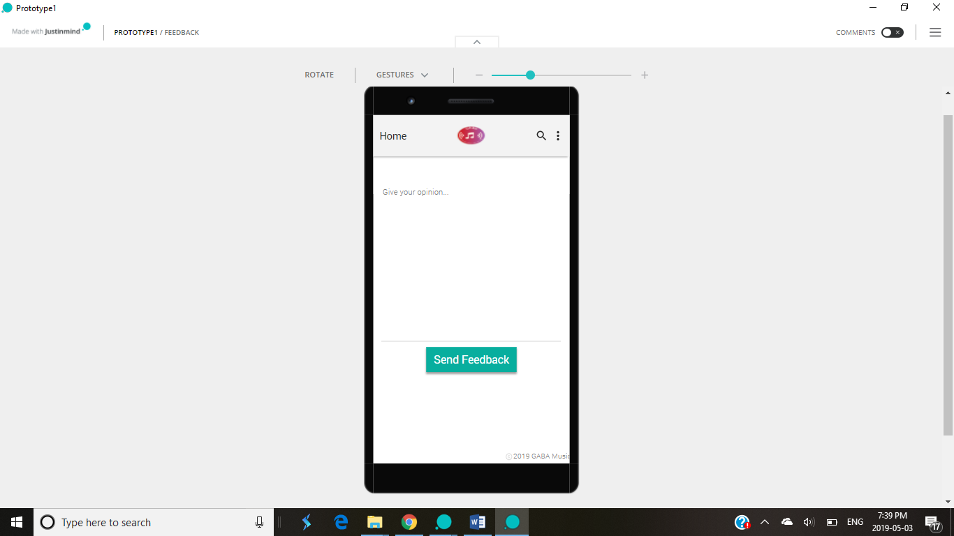
Gaba Feedback
What makes Gaba more different here is user’s feedback. Feedback is essential for upgrading and improving the durability of the application.

